Slide 1
Intro to OpenTelemetry (with C# Applications)
By Al Rodriguez
@ProgrammerAL
https://www.linkedin.com/in/programmeral

Slide 2
Quick Notes
GitHub Repo:
https://github.com/ProgrammerAl/Presentations-2023
Who is this for?
Developers
What language will we use?
C#, but concepts apply globally
Should you stop using logs and go all in with OTel?
No

Slide 3
Level Setting – What existed before OTel
1957
Fortran programming language created
Plain text log messages go to console/files

Slide 4
Cont. – What existed before OTel
2023+
More programming languages exist
Plain text log messages to console/files/3rd party company solution
Logs have higher verbosity, more data per line
Timestamp, log level, JSON output, Thread Id, Request Id, etc

Slide 5
Level Setting – Limitations of Plain Text Logs
Data in files is hard to sift through
Custom providers can make this way easier
You end up taking a big dependency on their solution
Example Scenario:
UI calls `Service A` which calls `Service B` which calls `Service C`
An exception occurs in `Service B` because of response from `Service C`
How do you debug that?

Slide 6
What is OpenTelemetry (OTel)?
A standard for collecting telemetry data about your services
Open Source, Vendor Neutral, Language Agnostic
https://opentelemetry.io/
A different way to log data
A programmatic way

Slide 7
Anything new in OTel?
Not really
Standardized functionality

Slide 8
What kind of data does OTel collect?
Traces
Tracks requests in the system
Can add custom spans
Metrics
Performance counters
Mostly Automatic
Install agent on box, set some config, leave it alone

Slide 9

OTel Metrics
Counters
CPU/Memory usage on the box
Requests per second
Has an API to write custom data to
Still in beta

Slide 10
OTel Traces
Information for a request
Can span multiple applications, all based on the Trace Id
Full information for a request
From beginning to end
Across multiple services

Slide 11
Trace Spans
Traces have child Spans
Track their own timing
Spans have child Attributes
Attributes are key/value pairs of data
Spans have child Events
Events are timestamped pieces of data in a span, can have their own attributes

Slide 12
Trace Spans Example
Trace is created when a request comes into the system
A span is made to wrap around call to database
Span stores time it took to run the database query
Another span is created when making call out to 3rd party service
Span stores time it took to run the HTTP request and the response HTTP status code, plus error if needed

Slide 13
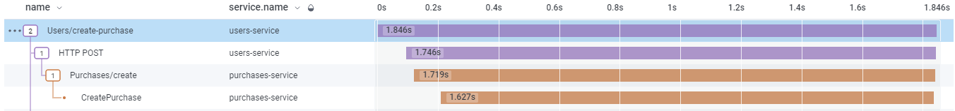
Traces

Slide 14
TraceContext
Passed around to track the parent Trace
Sometimes automatic, sometimes manually
“traceparent” Header
00-c9dafef5b02172ce9f19a70ee83e9fc8-4f78ce7bf9cb7d22-01
Separated by dashes:
Version Format
Trace Id
Parent Id
Trace Flags

Slide 15
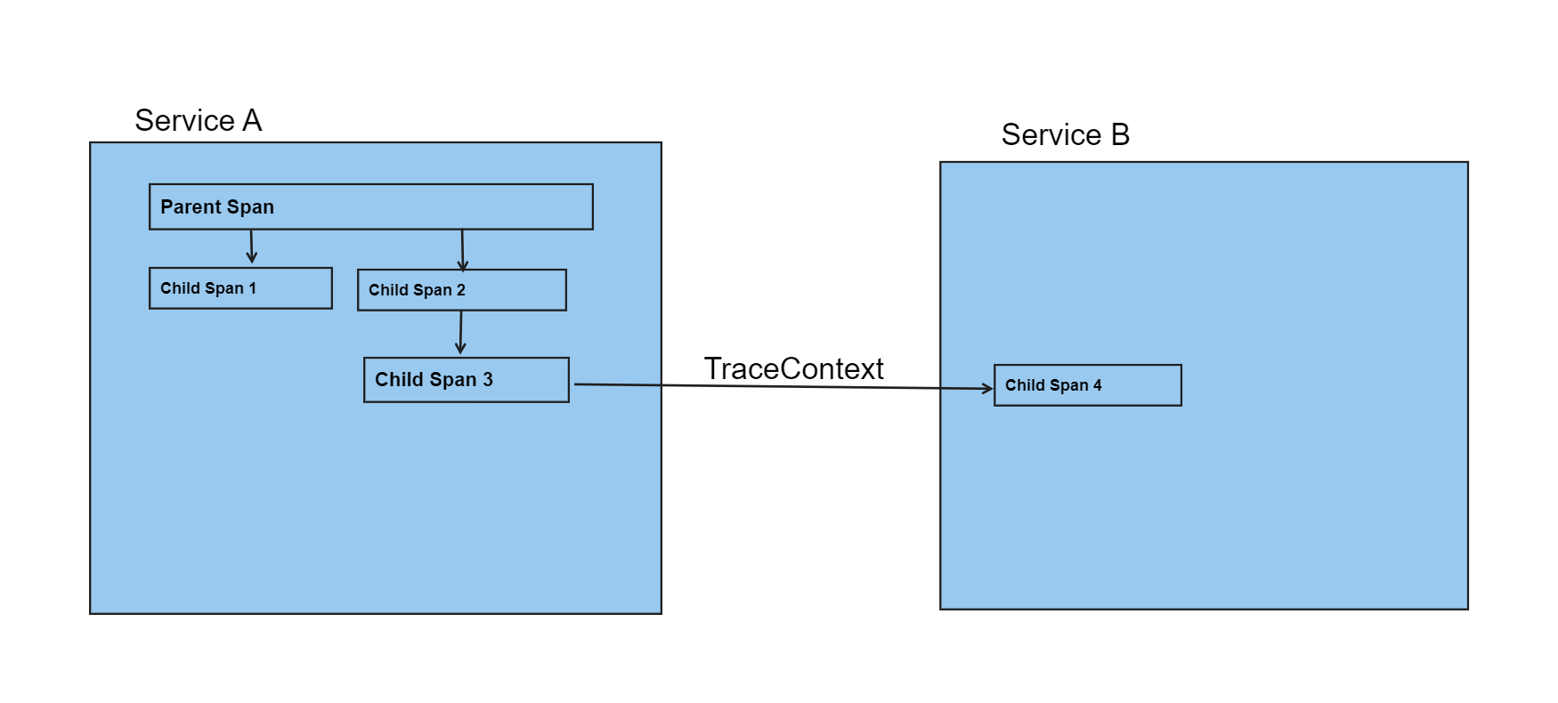
TraceContext Visual

Slide 16
OTel with C#
2 APIs
Because of course there are
Built in to .NET
OpenTelemetry community provided one

Slide 17
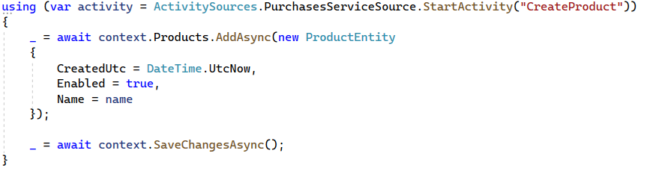
Built-In API - ActivitySource

Slide 18
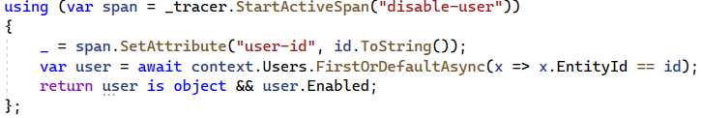
Community API – Trace and Span objects

Slide 19
Demo Code
Purchases Service
Uses SQL Server database
ActivitySource
Users Service
Uses Cosmos DB
When purchase made by User, makes HTTP call to Purchases Service
Trace/Span

Slide 20
Extra Items

Slide 21

Otel Log Records
Standalone Logs
A Span with an Event, no link to other Spans
Embedded Logs
An Event in a Span

Slide 22
OTel in the UI
Possible
JS library exists
Where does the Trace start?

